Slide 1
Simulations of E&R Under Neutrality and Selection - SLiM
Hannah Götsch & Yiwen Chen

Slide 2
This Afternoon
Neutrality
Brief introduction to genetic drift and the Wright-Fisher model
Brief introduction to SLiM
First Task: Simulate drift on one locus
Second Task: Simulate drift on multiple loci
Selection
Directional, stabilizing and diversifying selection
Third Task: Simulate directional selection
Fourth Task: Simulate stabilizing selection
Fifth Task: Simulate diversifying selection

Slide 3
Evolutionary Forces
Selection
Genetic Drift
Allele Frequency
Migration
Mutation
(Recombination)

Slide 4
Genetic Drift

Slide 5
Genetic Drift
Changes in allele frequencies due to stochastic (independent of external and heritable factors) sampling variation (in offspring number) in a finite population
Several models have been proposed. The most commonly used models are the Wright-Fisher model and the Moran model.

Slide 6
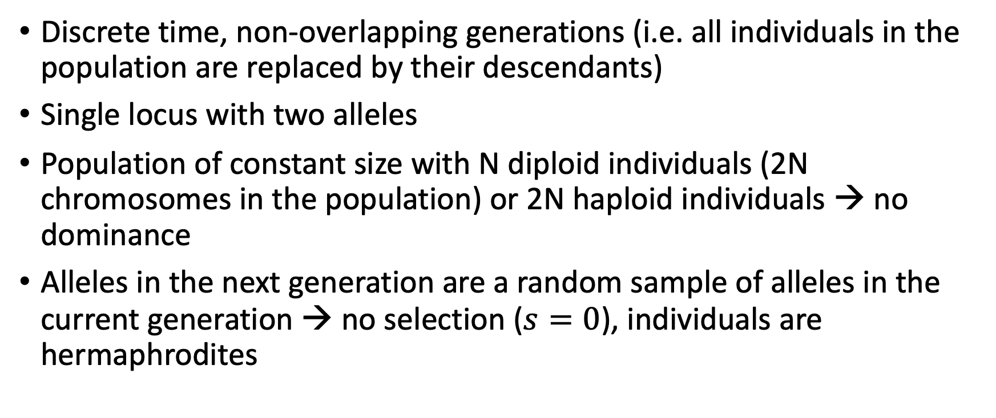
The Wright-Fisher Model – A Neutral Model
Discrete time, non-overlapping generations (i.e. all individuals in the population are replaced by their descendants)
Single locus with two alleles
Population of constant size with N diploid individuals (2N chromosomes in the population) or 2N haploid individuals → no dominance
Alleles in the next generation are a random sample of alleles in the current generation → no selection ($s=0$), individuals are hermaphrodites

Slide 7
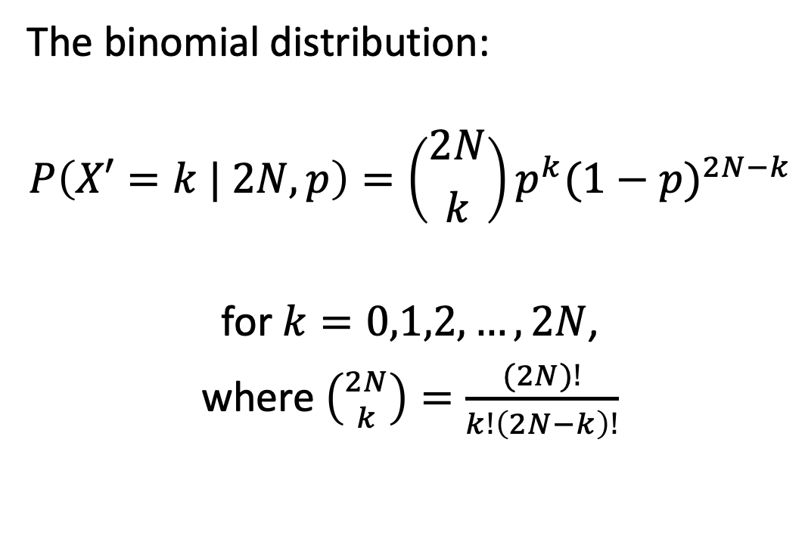
The WF Model – Drift as Binomial Sampling
The binomial distribution:
$$P\left(X′=k | 2N,p\right)=\left({2N \atop k}\right)p^{k}{(1−p)}^{2N−k}$$
for $k=0,1,2,…,2N$,
where $\left({2N \atop k}\right)=\frac{(2N)!}{k!\left(2N−k\right)!}$
population size (2)N
time
Notes:
2N=total number of tries
k=number of blue
p = frequency of blue in previous generation
The formula can be understood as follows. k successes occur with probability p^{k} and 2N − k failures occur with probability (1 − p)^{2N − k}. However, the k successes can occur anywhere among the 2N trials, and there are
{\displaystyle {\binom {2N}{k}}}
different ways of distributing k successes in a sequence of 2N trials.

Slide 8
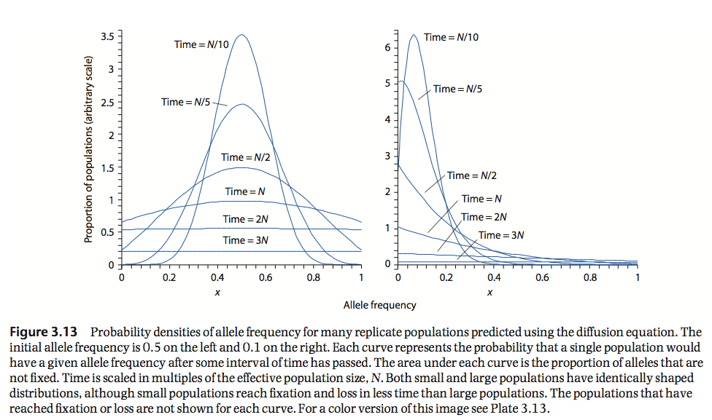
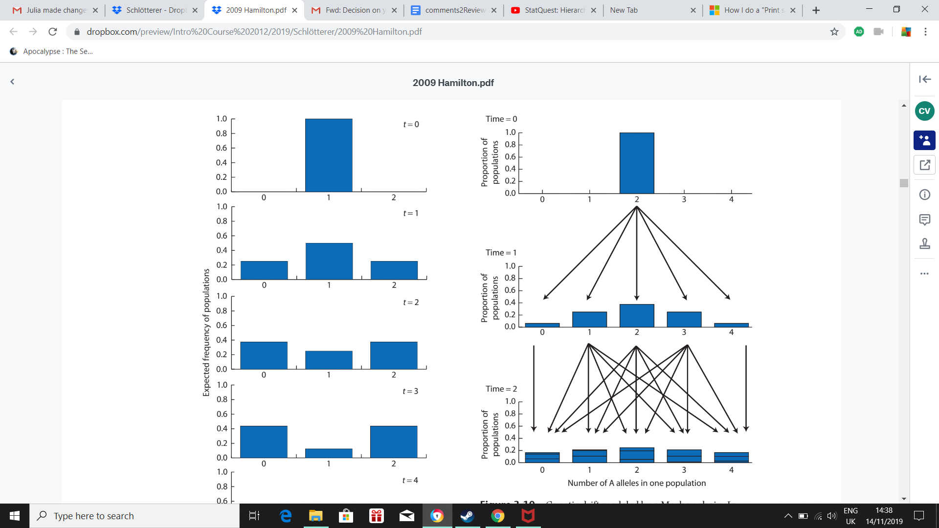
“Estimate” Drift – Two Approaches
Markov-Chain Model
Using the binomial distribution
Track the frequency changes of an allele by estimating the transition matrix
Diffusion Approximation
Figures from Hamilton, M. (2012). Population genetics. Chichester: Wiley-Blackwell.

Slide 9
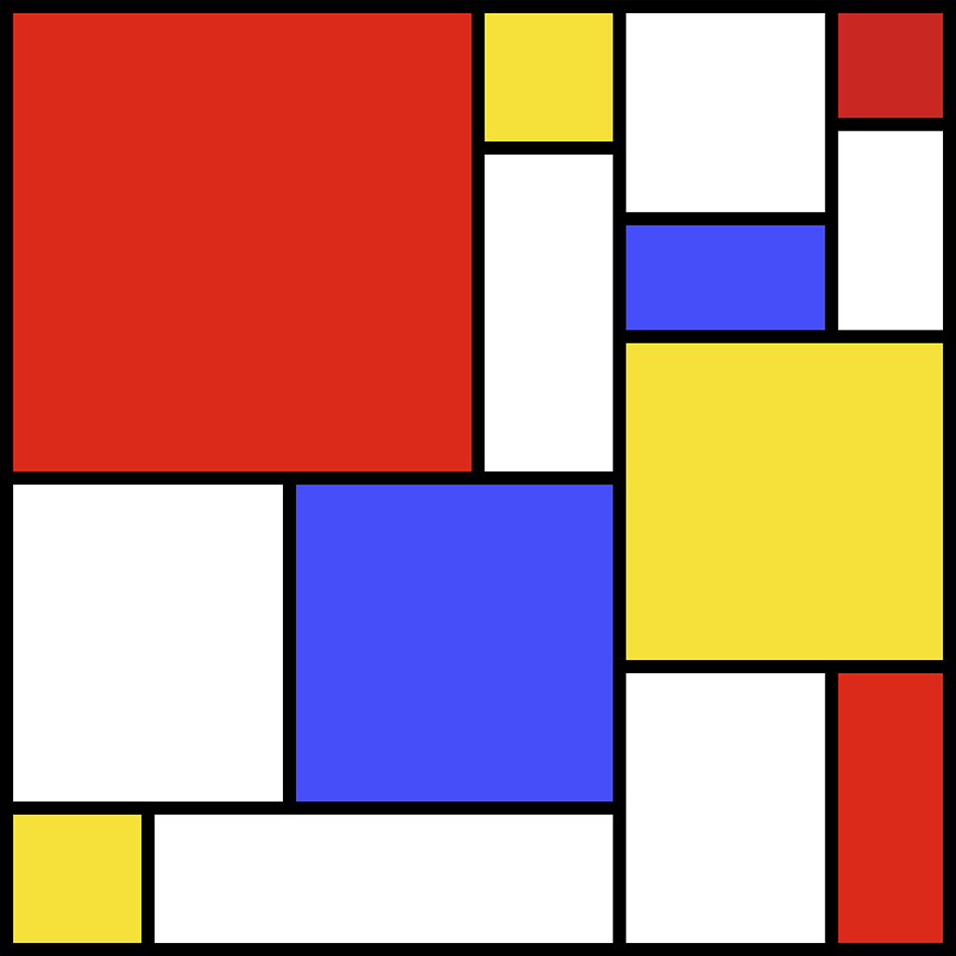
SLiM Selection on Linked Mutations
forward genetic simulation package
from the Messer Lab at Cornell University

Slide 10
SLiM - Materials
www.messerlab.org/slim/
SLiM Manual
Eidos Manual
Reference Sheets
Workshop (www.benhaller.com/workshops/workshops.html)
Mailing Lists (slim-announce & slim-discuss)

Slide 11
Why SLiM?
Open source on GitHub, GPL license
Interactive & graphical (SLiMgui)
Fast
Flexible & customizable with Eidos
Eidos is similar to R in syntax & function names, but ends statements with semicolons and is zero-based

Slide 12
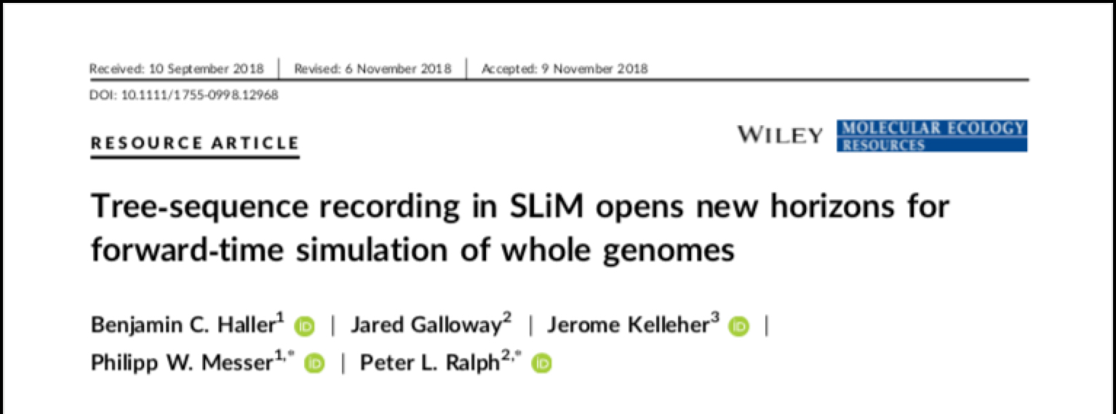
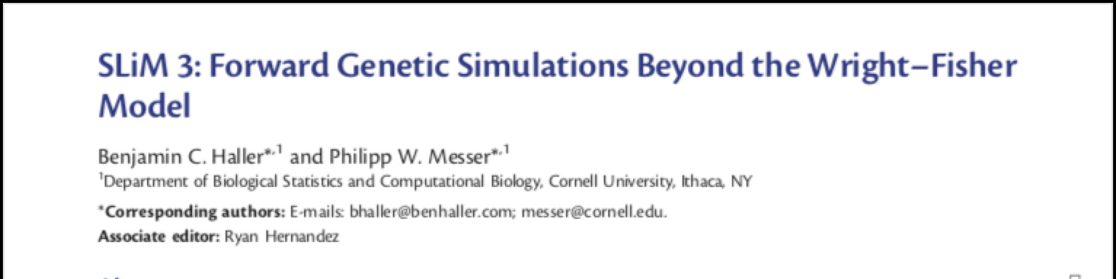
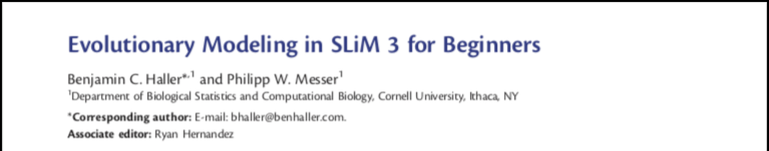
How to use SLiM?
Initial modeling in SLiMgui
SLiM Recipes
Production runs (on a cluster)
Post-run analysis in Eidos, Python, or R
(we use version 4.0.1 of SLiM)

Slide 13
SLiMgui Simulation Window
1. The scripting pane
2. The output pane.
3. The population view.
4. The individual view.
5. The tick controls.
6. The chromosome view.
Figure from the SLiM-Manual.
Notes:
show other stuff directly in SLiMgui

Slide 14
First Task
Simulate Drift on One Locus

Slide 15
Simulate Drift on One Locus
Neutral Wright-Fisher model
Single locus – two alleles
Fixed mutant frequency in the beginning, no additional mutations
Exercises:
Plot the allele frequency trajectory in SLiM. Vary the starting allele frequency (p), the population size (N) and the number of generations (t).
When is an allele more likely to get fixed or lost? What is the effect of p and N?
When do you expect an allele to remain the longest in the population (assuming the same N)?
Notes:
nWF1locus.slim

Slide 16
Multiple Replicates
Exercises:
Plot the allele frequency trajectories in SLiM.
Try to understand how the mean and variance of drift are affected by the following parameters:
Starting allele frequency (p)
Population size (N)
Number of generations (t)
How is the observed heterozygosity affected by the same parameters?
Notes:
one replicate for multiple unlinked loci
nWFmultipleloci.slim
E[p’]=p
Var[p’]=p(1-p)/(2N)
H=2p(1-p)
E[H’]=H(1-1/(2N))
E[H]=H0(1-1/(2N))^t

Slide 17
Second Task
Simulate Drift on Multiple Loci

Slide 18
Simulate Drift on Multiple Locus
Neutral Wright-Fisher model
Multiple loci
Exercises:
Plot the allele frequency trajectories in SLiM.
Plot the SFS in SLiM. How does it change with time?
Notes:
nWFmultipleloci.slim

Slide 19
Selection

Slide 20
Natural Selection
Each locus is assigned with selection coefficients (s). Allele with higher s result to higher individual fitness h… dominance coefficient w… individual fitness
W_{AA}=1+s
W_{Aa}=1+hs
W_{aa}=1

Slide 21
Natural Selection
Selection acts on phenotype, mostly not on a single locus:
✓ Higher fecundity is fitter than lower fecundity
✗ AA on rs12345678 is fitter than Aa
Combining all loci together => phenotype of an individual
Quantitative models of selection:
Fitness functions that define the relationship between phenotype and fitness:
Directional selection
Disruptive selection
Stabilizing selection

Slide 22
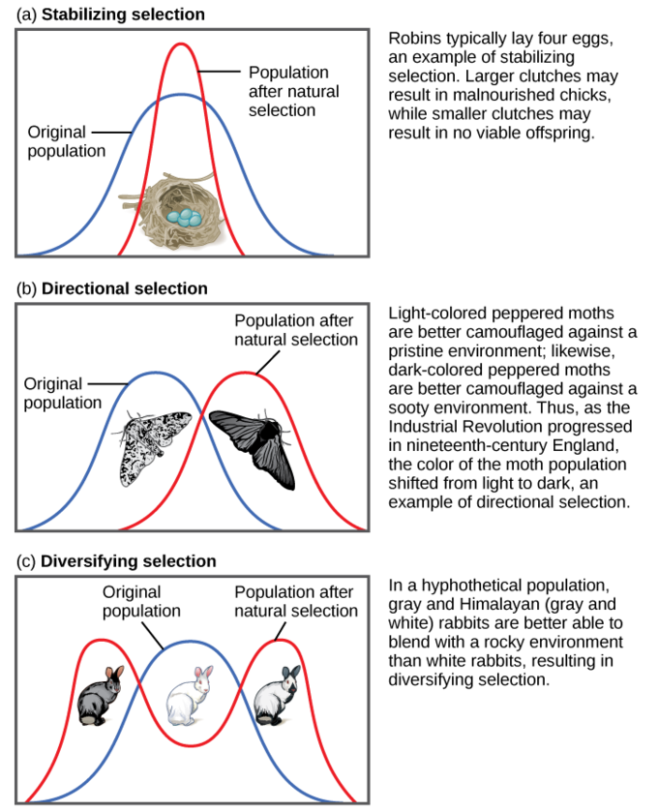
Natural Selection

Slide 23
Third Task
Simulate Directional Selection

Slide 24
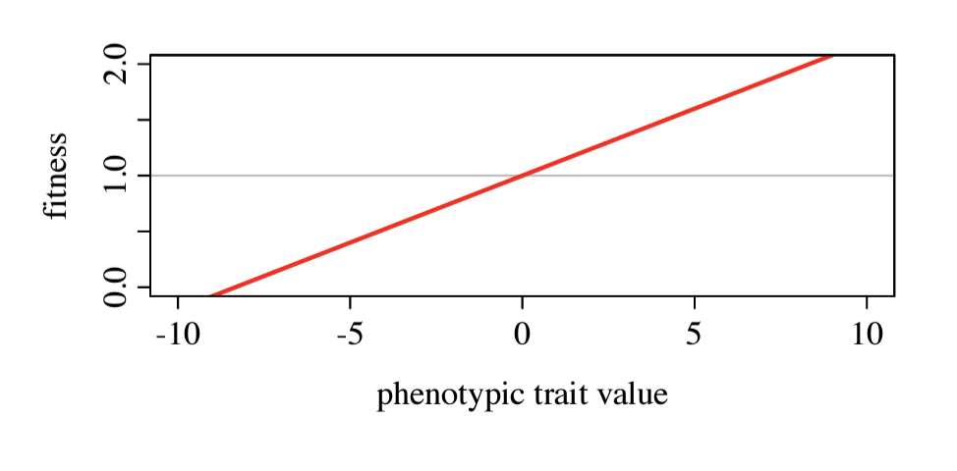
Directional Selection
Directional_selection.slim
Multi-loci
Multi population
Each locus doesn’t have any selection coefficient, they are all neutral in that sense.
Instead, we:
Calculate the phenotype of an individual
Acquire the fitness distribution in the population
Selection act on phenotype through the fitness function, ultimately changing the genotypes.
Linear relationship between phenotype and fitness

Slide 25
Directional Selection
Exercises:
Plot the Fitness ~ Time trajectories in SLiM.
Try to understand how the level and speed of fitness increase are affected by the following parameters:
Effect size of QTLs (5th parameter passed to initializeMutationType() )
Population size (N)
Recombination rate (r)
Next, check subpopulation fitness distribution, do you notice a different behavior among our subpopulations? Why is it? Does the variance of fitness distribution in a population change?

Slide 26
Fourth Task
Simulate Stabilizing Selection

Slide 27
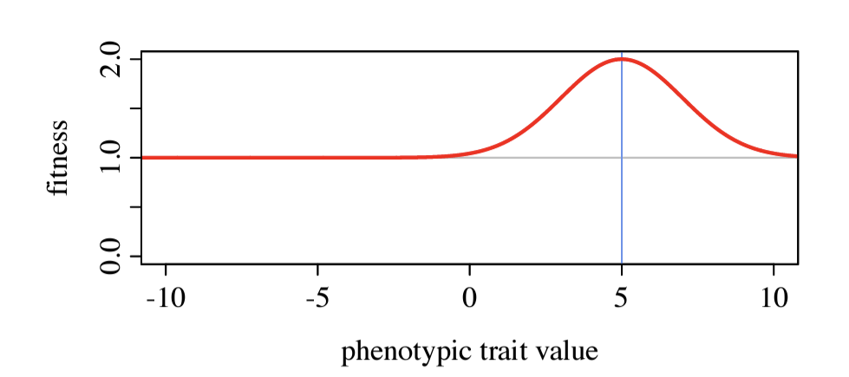
Stabilizing Selection
Stabilizing_selection.slim
Multi-loci
Multi population
Each locus doesn’t have any selection coefficient, they are all neutral in that sense.
Instead, we:
Calculate the phenotype of an individual
Acquire the fitness distribution in the population
Selection act on phenotype through the fitness function, ultimately changing the genotypes.
Peak of fitness when phenotype = 5 (a hypothetical situation)

Slide 28
Stabilizing Selection
Exercises:
Plot the Fitness ~ Time trajectories in SLiM
What is different from the directional selection?
Plot subpopulation fitness distribution, did they stop at some point? How many m2 type mutation is in the population reached in the trait optimum?
Play around with the effect size of m2, population size and scaling

Slide 29
Fifth Task
Simulate Diversifying Selection

Slide 30
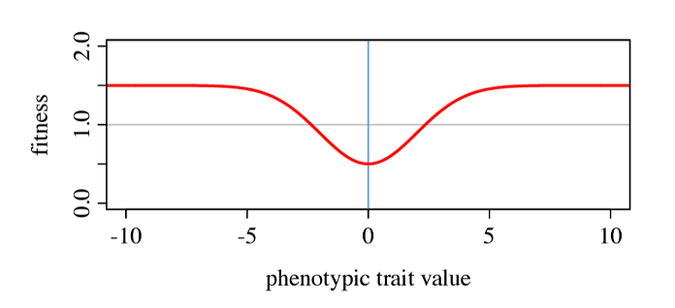
Diversifying Selection
Diversifying_selection.slim
Multi-loci
Multi population
Each locus doesn’t have any selection coefficient, they are all neutral in that sense.
Instead, we:
Calculate the phenotype of an individual
Acquire the fitness distribution in the population
Selection act on phenotype through the fitness function, ultimately changing the genotypes.
Valley of fitness when phenotype = 0 (a hypothetical situation)

Slide 31
Diversifying Selection
Exercises:
Plot the Fitness ~ Time trajectories in SLiM
Looks like stabilizing selection, why?
Check the auto-generated Rplot, how does the phenotypic change look?
Copy the plotting function to the stabilizing selection script to have a similar view

Slide 32
Final model for generating the data
1000 selected SNPs, additive

Slide 33
VCF file format

Slide 34
Combine individual VCFs into pool VCF
bgzip test.t.vcf
bcftools index test.t.vcf.gz
bcftools +fill-tags test.t.vcf.gz -Ob -o test.af.out.bcf -- -t AF

Slide 35
Alternative final model
Natural D.sim base population vcf file
100 generations’ simulation under stabilizing selection with assigned s at 100 loci.

Slide 36
Provide selection targets and generate date for next day workshop
Genetic variation at start ~ the generation it takes to reach trait optimum

